Slide 1


HOUSE RENT MANAGEMENT SYSTEM
Sushant Mhatre 21104002
Pratik Ingale 21104048
Darshan R. Patil 21104077

Slide 2
Contents
Introduction
Objectives
Scope
Features / Functionality
Project Outcomes
Technology Stack
Block Diagram

Slide 3
1. Introduction
HRMS is an ironic function in the human culture and ever growing modern generation .
Project allows the customers to create their housing / residence records in our registry .
Project provides facilities like residence management and members information.
Project provides facility like notice for members.
Project also provides the data about the transaction of members.

Slide 4
2. Objective
To easily edit the data.
To provide information of members.
To Maintain Accounts of members .
To easily enter the required information, and maintain the flow the System .
To show user there home rent details.

Slide 5
3. Scope
To have a proof of debt and previous records.
To maintain the data of the customer accurately.
To keep them up to date through out the events.
To keep there transaction history in one place.

Slide 6
4. Feature /Functionality
Authentication
System provides a user id and a password to login users account providing high security
Comfortable Maintenance.
Any operator or developer can easily change the system as per requirement of system.

Slide 7
5. Outcome of the Project
Allow the users to create their personal account.
Provide excellent authentication features.
Allow user to add ,update ,edit.
Allow the user to see his own home details.

Slide 8
6. Technology Stack
Backend Technology: MySQL
Language: Java (16.0.1)
Framework: Java Framework
Development Tools: NETBEANS IDE v.12.5
Web Server Hosting Technology: XAMPP

Slide 9
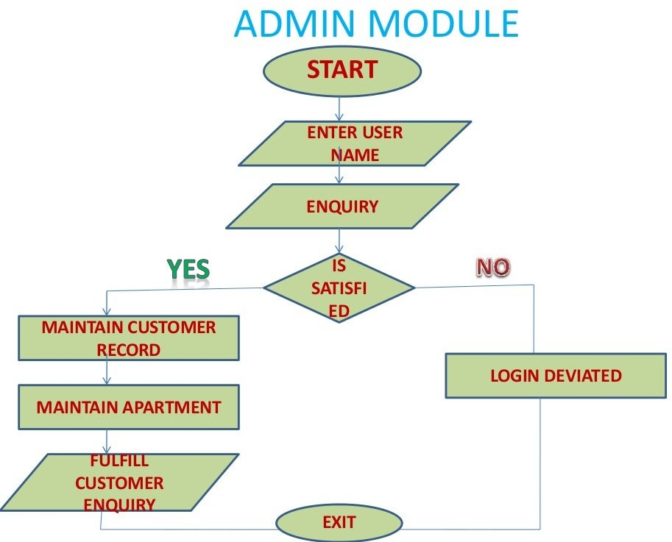
Block Diagram

Slide 10
Thank You!

